Slide 1
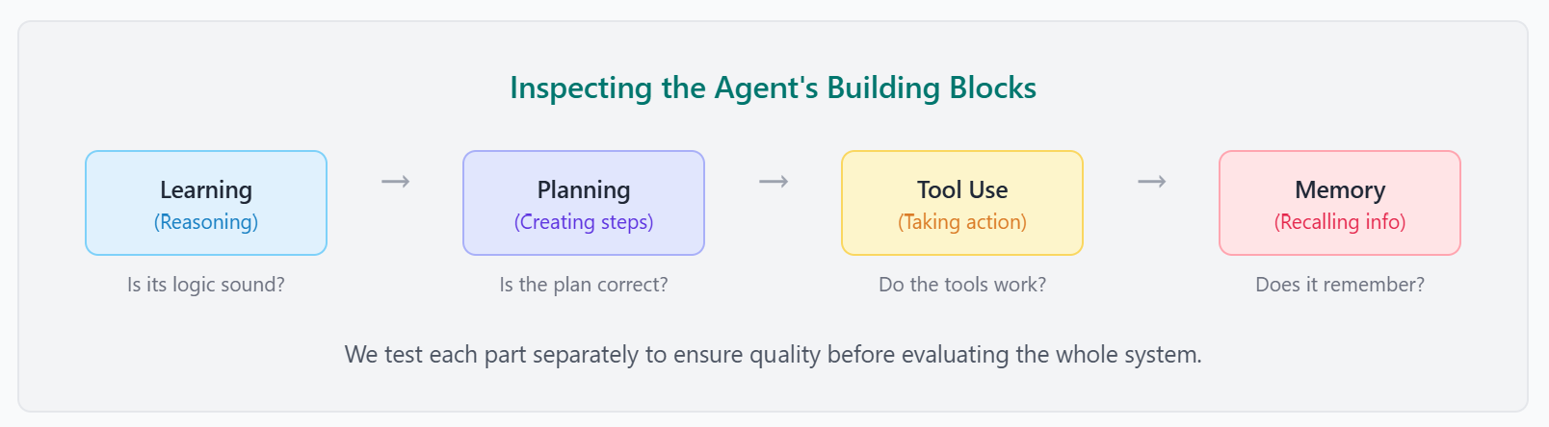
Component Evaluation
Before running a full road test, a mechanic inspects the engine, brakes, and transmission individually. Similarly, before testing an entire agent system, it's crucial to evaluate its individual components in isolation. This 'unit testing' approach helps pinpoint weaknesses early, making the whole system more robust. We primarily evaluate four key areas: the model's reasoning, its planning ability, its tool use, and its memory.

Slide 2
1. Evaluating Learning & Reasoning (The Core Model)
This is the most fundamental test: does the agent's 'brain' work? We assess the core Large Language Model's ability to reason, follow complex instructions, and generate the internal 'thoughts' or chain-of-thought steps that precede an action. A good agent doesn't just pick the right tool; it understands *why* it's the right tool.
What to look for in Agent 'Thoughts'
Logical Consistency: Is the reasoning sound, or does it make logical leaps?
Intent Interpretation: Did it correctly understand the user's goal?
Constraint Adherence: Did it follow all explicit instructions and constraints?
Knowledge Application: Did it correctly apply its knowledge to the problem?
Evaluation at this level is often qualitative. It involves reviewing agent logs to check the model's reasoning, as shown below. For more scalable feedback, an 'LLM-as-a-Judge' pattern can be used to score the coherence of the agent's thought process.
Notes:
thought: "The user wants to know the capital of France. This is a factual query. I should use the 'search' tool for this."
action:
tool: "search"
tool_input: "capital of France"
observation: "Paris"
thought: "I have found the answer. I will now output it to the user in a clear sentence."
action:
tool: "final_answer"
tool_input: "The capital of France is Paris."

Slide 3
2. Evaluating Planning
Once the agent has reasoned about a goal, its planning module transforms that goal into a sequence of concrete, actionable steps (e.g., a series of tool calls). We can assess the quality of this plan by comparing the agent's chosen tool calls against a known-good 'golden' plan. This interactive simulator demonstrates key planning metrics.

Slide 4
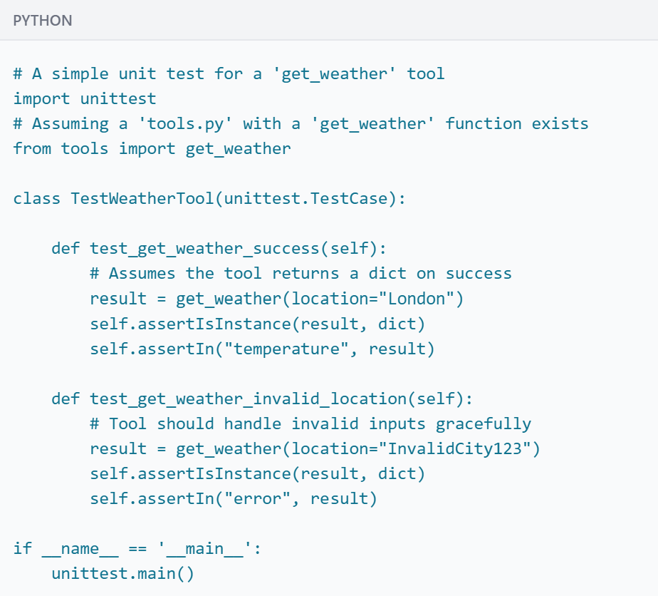
3. Evaluating Tool Use
While 'Planning' evaluates whether the agent chose the *right* tool for the job, 'Tool Use' evaluation verifies that the tool *itself* executes correctly and reliably. This is closer to traditional software testing, where we write unit tests for individual functions to ensure they are robust.
Execution Success: Does the tool run without crashing or raising unhandled exceptions?
Output Correctness: Does the tool return the expected data in the correct format?
Error Handling: How does the tool behave with invalid or malformed inputs? It should fail gracefully, not crash.
Latency: Does the tool execute within an acceptable time frame?

Slide 5
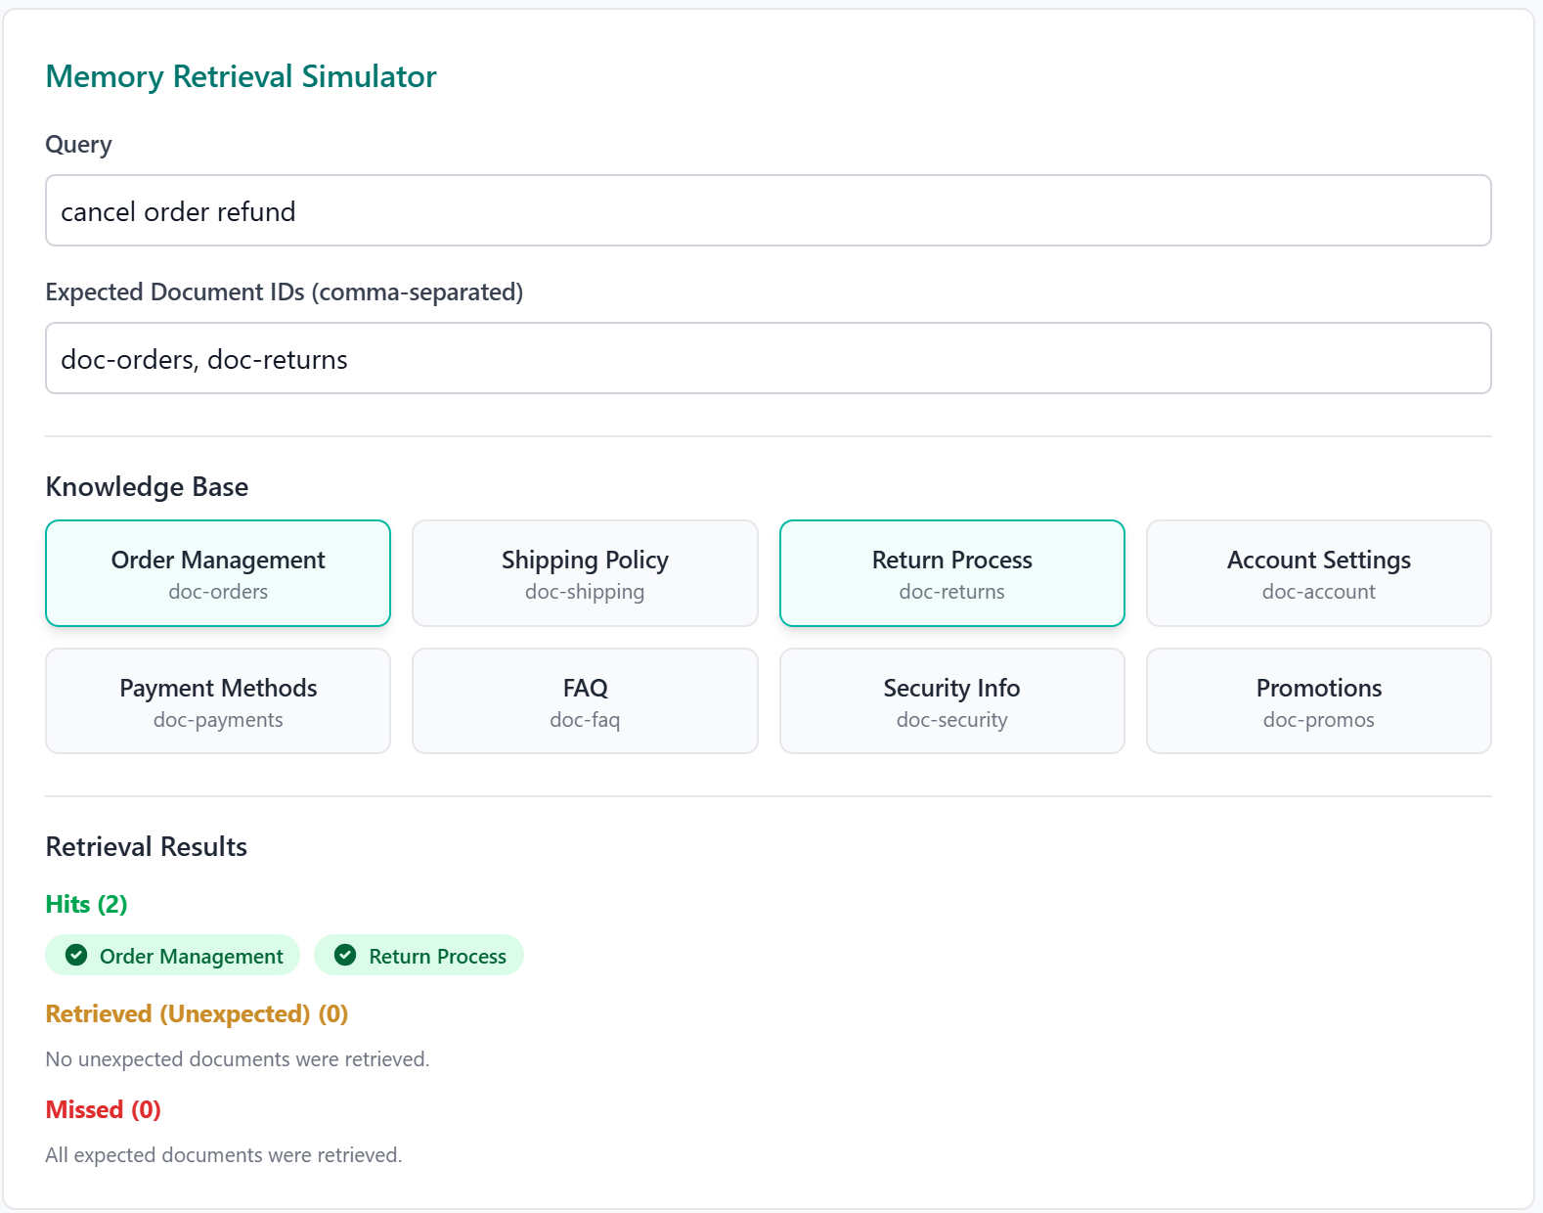
4. Evaluating Memory
For agents that handle multi-turn conversations or long-running tasks, memory is essential for providing context and continuity. Memory tests should verify that data is stored and retrieved accurately and that irrelevant data is ignored to avoid confusion. This simulator demonstrates a simple memory retrieval evaluation.

Slide 6
5. Evaluating Trajectory: Putting It All Together
The agent's 'trajectory' is the full sequence of its thoughts and actions. Evaluating the trajectory is a composite test that assesses how well learning, planning, and tool use work together. By comparing the agent's actual trajectory to an ideal one, we can find inefficiencies or errors in the overall reasoning process.
Exact Match: Requires a perfect match to the ideal trajectory. Best for high-stakes, predictable workflows.
In-Order Match: Requires the correct actions in the correct order but allows for extra, non-essential actions.
Any-Order Match: Requires the correct actions in any order, allowing for more flexibility.
Precision & Recall: Measures the relevance of the predicted actions and how many of the essential actions were correctly identified.

Slide 7
Evaluation Component | Focus Area | Evaluation Methods & Metrics | Example/Illustration
Trajectory | Sequence of actions executed by the agent | - Exact Match (perfectly matches ideal actions)- In-Order Match (correct actions in correct order, allows extra actions)- Any-Order Match (correct actions, any order)- Precision & Recall (measures relevant and essential actions identified) | Ideal vs. Predicted tool-call sequence (e.g., searching databases, calling APIs)
Learning (Core Model) | Model reasoning, understanding, and internal thought processes | - Qualitative Evaluation (manual log review)- LLM-as-a-Judge (scalable scoring of coherence, logic) | Reviewing agent logs:thought → action → observation → final_answer
Planning | Quality of agent's chosen tools/actions based on a given goal | - Precision (correctness of predicted tools/actions)- Recall (coverage of essential tools/actions) | Simulator comparing predicted vs. expected JSON tool calls (e.g., search_flights, search_hotels)
Tool Use | Reliability and correctness of individual tool execution | - Execution Success (no crashes/errors)- Output Correctness (expected data & format)- Error Handling (graceful failures on invalid input)- Latency (acceptable execution time) | Unit tests for individual tool execution (e.g., get_weather(location="London"))
Memory | Accurate data storage, retrieval, and ignoring irrelevant information | - Retrieval Accuracy (correctness in stored data retrieval)- Precision & Recall (hits, misses, and irrelevant data retrieval) | Memory Retrieval Simulator (e.g., querying "cancel order refund," expecting document retrieval: doc-orders, doc-returns)

